Slide 1

Machine Learning for Data Analysis MSc in Data Analytics CCT College Dublin
Association Rules – Market Basket Analysis
Week 10
Lecturer: Dr. Muhammad Iqbal*
Email: miqbal@cct.ie

Slide 2
Agenda
Introduction
Affinity Analysis
Market Basket Analysis
Support and Confidence
Lift and Leverage
Conviction
Characteristics of Transaction Data
The Apriori Principle
FP Growth Algorithm

Slide 3
Introduction
Suppose you are working as a manager in a super market and your boss comes to you and asks the following questions
Which products are purchased together most frequently?
How should the products be organized and positioned in the store?
How do we identify the best products to discount via coupons?
You might respond with complete bewilderment, as those questions are very diverse and do not immediately answerable using a single algorithm and dataset.
However, the answer to all those questions and many more is Market Basket Analysis.
The general idea behind Market Basket Analysis is to identify and quantify which items, or groups of items, are purchased together frequently enough to drive insight into customer behaviour and product relationships.
Notes:
bewilderment: a feeling of being perplexed and confused.

Slide 4

Introduction
Affinity analysis is the study of attributes or characteristics that “go together.” Methods for affinity analysis, also known as market basket analysis, seek to uncover associations among these attributes.
Association Rules take the form “If antecedent, then consequent,” along with a measure of the support and confidence associated with the rule. For example, a particular supermarket may find that of the 1000 customers shopping on a Thursday night, 200 bought diapers, and of the 200 who bought diapers, 50 bought beer. Thus, the association rule would be
“If buy diapers, then buy beer,” with a support of 50/1000 = 5% and a confidence of 50/200 = 25%.
Examples of association tasks in business and research are the following
Investigating the proportion of subscribers to your company's cell phone plan that respond positively to an offer of a service upgrade
Predicting degradation in telecommunications networks
Finding out which items in a supermarket are purchased together, and which items are never purchased together
Determining the proportion of cases in which a new drug will exhibit dangerous side effects

Slide 5
Market Basket Analysis: Association rules
Market basket analysis (MBA) is a set of statistical affinity calculations that help the managers to better understand – and ultimately serve – their customers by highlighting purchasing patterns.
Association rule mining is a technique that focuses upon observing frequently occurring patterns and associations from datasets found in the databases, such as relational and transactional databases.
These rules do not say anything about the preferences of an individual, but they rely on the items within transactions to deduce a certain association.
Every transaction is identified by a primary key (distinct ID) called, transaction ID. All these transactions are studied as a group and patterns are mined. Association rules can be thought of as an if - then relationship.
We develop a rule: if an item A is being bought by the customer, then the chances of item B being picked by the customer too under the same transaction ID (along with item A) is found out.
Notes:
Causality is influence by which one event, process, state or object contributes to the production of another event, process, state or object where the cause is partly responsible for the effect, and the effect is partly dependent on the cause.

Slide 6
Market Basket Analysis Association rules
There are two elements of these rules
Antecedent (if): This is an item/ group of items that are typically found in the item sets or datasets.
Consequent (then): This comes along as an item with an antecedent/ group of antecedents.
We can see at the following rule
{Bread, milk} ⇒ {Butter}
The first part of this rule is called as antecedent and the second part (after the arrow) is called as consequent.
It is able to convey that there is a chance of Butter being picked in a transaction if Bread and Milk are picked earlier. However, the percentage chance for the consequent to be present in an itemset is not clear.
Notes:
Let's take the relationship between meat and vegetables. So what?
Well, we know these are staple items that are frequently purchased together. We can leverage this information by putting the vegetables and meats on opposite sides of the store, which you will notice is the positioning of those two items, forcing customers to walk the full distance of the store, and so increasing the likelihood that they will buy additional items that they might not have bought had they not traversed the whole store.
One of the things retail companies struggle with is how to discount items effectively?
Let's consider another relationship: peanut butter and jelly.
In the United States, peanut butter and jelly sandwiches are incredibly popular, especially among children. When peanut butter is in a shopping basket, the chance jelly is also there can be assumed to be quite high. Since we know peanut butter and jelly are purchased together, it does not make sense to discount them both. If we want customers to buy both items, we can just discount one of the items, knowing that if we can get the customers to buy the discounted item, they will probably buy the other item too, even if it is full price.

Slide 7
Support
Support is simply the probability that a given item set appears in the data, which can be calculated by counting the number of transactions in which the item set appears and dividing that count by the total number of transactions.
An item set can be a single item or a group of items. It is one of the primary metrics used to determine the believability and strength of association between groups of items.
Note that since support is a probability, it will fall in the range [0, 1]. The formula takes the following form if the item set is two items, X and Y, and N is the total number of transactions
Example:

Slide 8
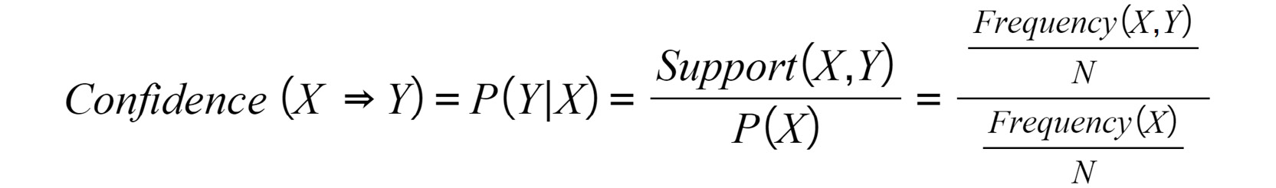
Confidence
The confidence metric can be thought of in terms of conditional probability, as it is basically the probability that product B is purchased given the purchase of product A.
Like support, confidence is a probability, so its range is [0, 1]. Using the same variable definitions as in the Support, the following is the formula for confidence
Example:
Notes:
To demonstrate confidence, we will use the items beer and wine. Specifically, let's compute the confidence of Beer Wine. To begin, we need to identify the transactions that contain beer. There are three of them, and they are transactions 2, 6, and 7. Now, of those transactions, how many contain wine? The answer is all of them. Thus, the confidence of Beer Wine is 1. Every time a customer bought beer, they also bought wine. It might be obvious, but for identifying actionable associations, higher confidence values are better.

Slide 9
Lift and Leverage
When lift equals 1, the two products are independent and, hence, no conclusions can be made about product B when product A is purchased
Leverage calculates the difference between the two cases, so its range is [-1, 1].
Leverage equaling zero can be interpreted the same way as lift equaling one.
A value of lift other than 1 means that some dependency exists between the items.
Notes:
The values of the metrics measure the degree and orientation (in other words, positive or negative) of the relationship between the items.
A value of lift other than 1 means that some dependency exists between the items. When the value is greater than 1, the second item is more likely to be purchased if the first item is purchased. Likewise, when the value is less than 1, the second item is less likely to be purchased if the first item is purchased.
If the lift value is 0.1, we could say that the relationship between the two items is strong in the negative direction.
A lift of 1 indicates that the products are independent of one another.

Slide 10

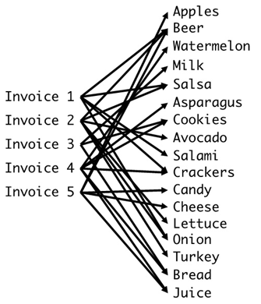
Conviction
Conviction is the ratio of the expected frequency that X occurs without Y, given that X and Y are independent of the frequency of incorrect predictions.
A value greater than 1 is ideal because that means the association between products or item sets X and Y is incorrect more often if the association between X and Y is random (in other words, X and Y are independent).
The data used in the market basket analysis is transaction data or any type of data that resembles transaction data.
In its most basic form, transaction data has some sort of transaction identifier, such as an invoice or transaction number, and a list of products associated with said identifier.
Transaction data includes pricing information, dates and times, and customer identifiers, among many other things.
How is each product mapped to multiple invoices?
Notes:
Let's again return to the products beer and wine, but for this explanation, we will consider the opposite association of Wine Beer. Support(Y) or, in this case, Support(Beer) is 3/10, and Confidence X Y, or, in this case, Confidence(Wine Beer) is 3/4. Thus, the Conviction(Wine Beer) is (1-3/10) / (1-3/4) = (7/10) * (4/1). We can conclude by saying that Wine Beer would be incorrect 2.8 times as often if wine and beer were independent. Thus, the previously articulated association between wine and beer is legitimate.

Slide 11
The Apriori Principle
The Apriori algorithm is a data mining methodology for identifying and quantifying frequent item sets in transaction data and is the foundational component of association rule learning.
Frequency is quantified as support, so the value input into the model is the minimum support acceptable for the analysis being done.
The model identifies all item sets whose support is greater than, or equal to, the minimum support provided to the model.
The minimum support hyperparameter is not a value that can be optimized via grid search because there is no evaluation metric for the Apriori algorithm. Instead, the minimum support parameter is set based on the data, the use case, and domain expertise.
The main idea behind the Apriori algorithm is the Apriori principle: any subset of a frequent item set must itself be frequent.
Another aspect worth mentioning is the corollary: no superset of an infrequent item set can be frequent.

Slide 12
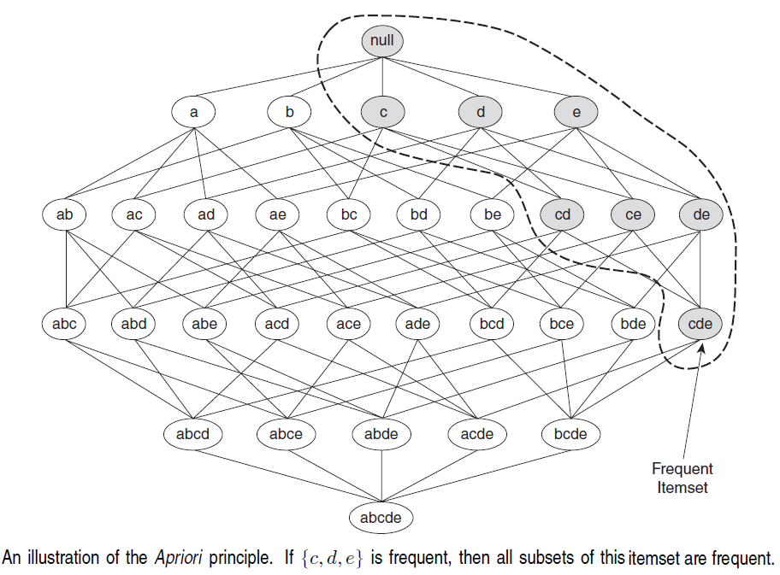
The Apriori Principle
To illustrate the idea behind the Apriori principle, consider the itemset Iattice as shown in Figure.
Suppose {c, d, e} is a frequent itemset. Clearly, any transaction that contains {c, d, e} must also contain its subsets, {c, d}, {c, e}, {d, e}, {c}, {d}, and {e}. As a result, if {c, d, e} is frequent, then all subsets of {c, d, e} (i.e., the shaded item sets in this figure) must also be frequent.
We can see that the support measure helps us to reduce the number of candidate item sets explored during frequent itemset generation.
The use of support for pruning candidate item sets is guided by the following principle. If an itemset is frequent, then all of its subsets must also be frequent.

Slide 13
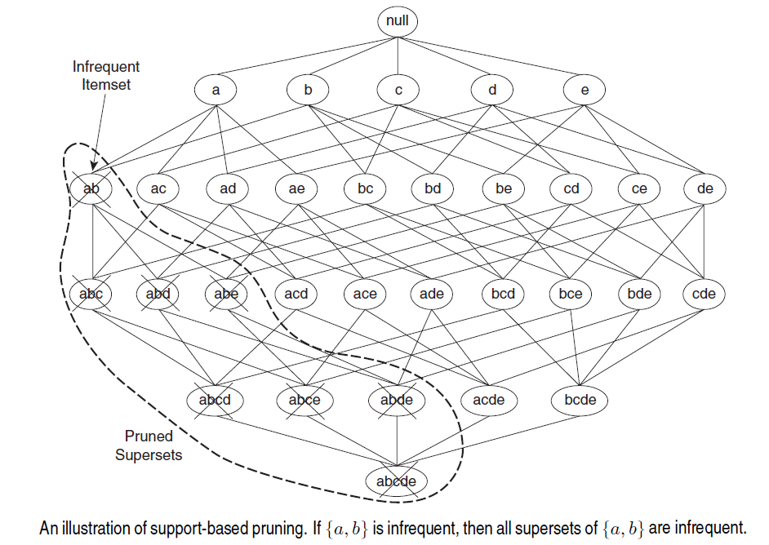
The Apriori Principle
If an itemset such as {a, b} is infrequent, then all of its supersets must be infrequent too.
The entire subgraph containing the supersets of {a, b} can be pruned immediately once {a, b} is found to be infrequent.
This strategy of trimming the exponential search space based on the support measure is known as support-based pruning.
Such a pruning strategy is made possible by a key property of the support measure, namely, that the support for an itemset never exceeds the support for its subsets.
This property is also known as the anti-monotone property of the support measure.

Slide 14
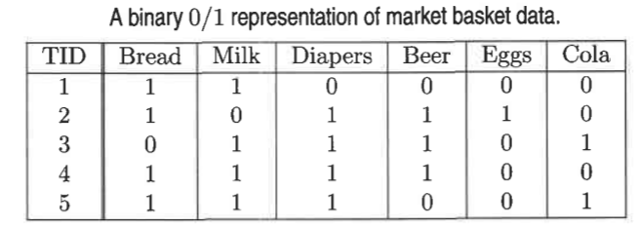
Illustrating Apriori Principle
Items (1-itemsets)
Pairs (2-itemsets)
(No need to generate candidates involving Coke or Eggs)
Minimum Support = 3

Slide 15
Illustrating Apriori Principle
Items (1-itemsets)
Pairs (2-itemsets)
(No need to generate candidates involving Coke or Eggs)
Minimum Support = 3

Slide 16
Illustrating Apriori Principle
Items (1-itemsets)
Pairs (2-itemsets)
(No need to generate candidates involving Coke or Eggs)
Minimum Support = 3
Triplets (3-itemsets)

Slide 17
Illustrating Apriori Principle
Items (1-itemsets)
Pairs (2-itemsets)
(No need to generate candidates involving Coke or Eggs)
Minimum Support = 3
Triplets (3-itemsets)
Notes:
{Bread, Diaper, Milk} = (Bread, Milk, 3), (Milk, Diaper, 3), (Bread, Diaper, 3)
{Beer, Bread, Diaper} = (Beer, Bread, 2), (Bread, Diaper, 2), (Beer, Diaper, 3)
{Beer, Diaper, Milk} = (Beer, Diaper, 3), ((Beer, Milk, 2), (Diaper, Milk, 3)

Slide 18
Illustrating Apriori Principle
Items (1-itemsets)
Pairs (2-itemsets)
(No need to generate candidates involving Coke or Eggs)
Minimum Support = 3
Triplets (3-itemsets)
Use of F_{k-1} x F_{k-1} method for candidate generation results in
only one 3-itemset. This is eliminated after the support counting step.
Notes:
(Bread, Milk, Diapers), (Bread, Milk, Beer), (Milk, Diapers, Beer), (Beer, Diapers, Bread) = 4
(Bread, Milk), (Bread, Diapers), (Bread, Beer), (Milk, Diapers), (Milk, Beer), (Diapers, Beer) = 6
As {Bread, Beer} are less frequent than others, so all its superset will be infrequent.
As {Milk, Beer} are less frequent than others, so all its superset will be infrequent.

Slide 19
Apriori Algorithm
F_{k}: frequent k-itemsets
L_{k}: candidate k-itemsets
Algorithm
Let k = 1
Generate F₁ = {frequent 1-itemsets}
Repeat until F_{k} is empty
Candidate Generation: Generate L_{k+1} from F_{k}
Candidate Pruning: Prune candidate item sets in L_{k+1} containing subsets of length k that are infrequent.
Support Counting: Count the support of each candidate in L_{k+1} by scanning the DB.
Candidate Elimination: Eliminate candidates in L_{k+1} that are infrequent, leaving only those that are frequent => F_{k+1}

Slide 20
FP-Growth Algorithm
Frequent Patterns (FP-growth) is an improved version of the Apriori Algorithm which is widely used for frequent pattern mining (AKA Association Rule Mining).
The method involved repeatedly searching the entire transaction database to create costly pattern candidates that were longer and longer, then evaluating their support.
The fundamental concept behind FP-growth is to first carefully scan the transaction database D of interest, identify all of the frequently occurring patterns of length 1, and then construct an FP-tree (a unique type of tree structure) based on these patterns.
After this step is completed, we perform recursive computations on the typically much smaller FP-tree rather than working with D.
Since it builds trees recursively from the original tree's subtrees in order to find patterns, this stage of the algorithm is known as the FP-growth step.
This process, which we will refer to as fragment pattern growth, is based on a divide-and-conquer tactic that significantly lowers the workload in each recursion step rather than requiring us to generate candidates.

Slide 21
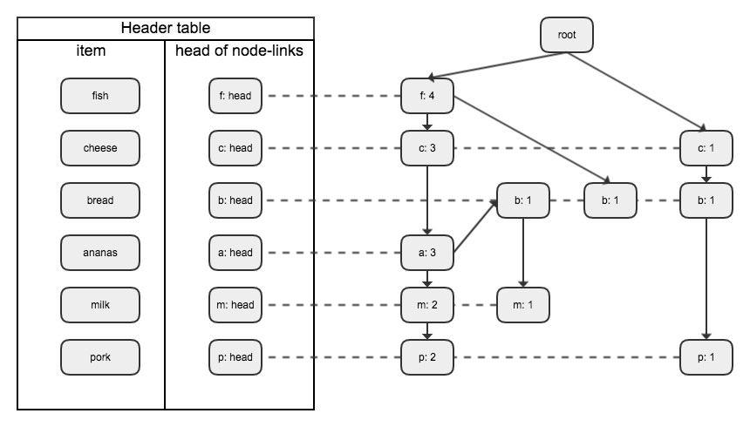
FP-Growth Algorithm
The two primary drawbacks of the Apriori Algorithm are
At each step, candidate sets have to be built.
To build the candidate sets, the algorithm has to repeatedly scan the database.
Step 1: Deduce the ordered frequent items. For items with the same frequency, the order is given by the alphabetical order.
Step 2: Construct the FP-tree from the above data
Step 3: From the FP-tree above, construct the FP-conditional tree for each item (or itemset).
Step 4: Determine the frequent patterns.
Let’s take a look at an example of how to generate an FP-tree. Find all frequent item sets with support ≥ 2. First, find all items with support count ≥ 2.

Slide 22
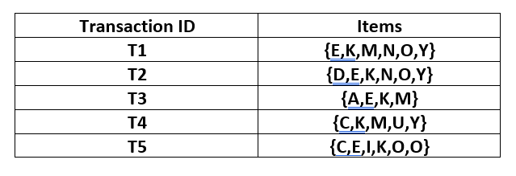
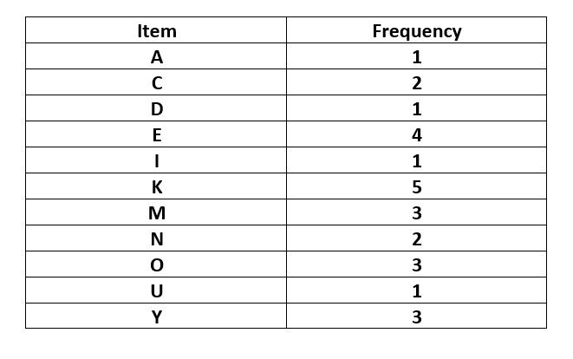
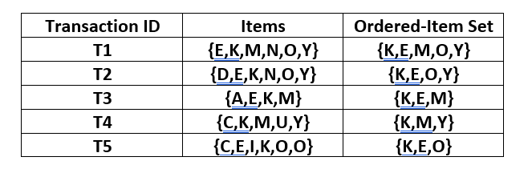
FP-Growth Algorithm
The given data is a hypothetical dataset of transactions with each letter representing an item. The frequency of each individual item is computed.
Let the minimum support be 3. A Frequent Pattern set is built which will contain all the elements whose frequency is greater than or equal to the minimum support.
These elements are stored in the descending order of their respective frequencies. After insertion of the relevant items, the set L looks like this
L = {K : 5, E : 4, M : 3, O : 3, Y : 3}
For each transaction, the respective Ordered-Item set is built. It is done by iterating the Frequent Pattern set and checking if the current item is contained in the transaction in question.
If the current item is contained, the item is inserted in the Ordered-Item set for the current transaction. The following table is built for all the transactions.

Slide 23
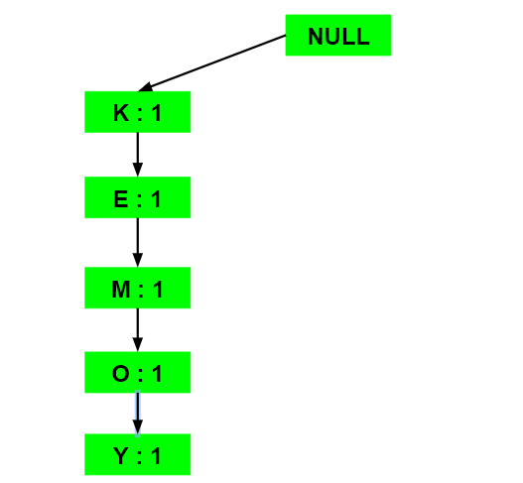
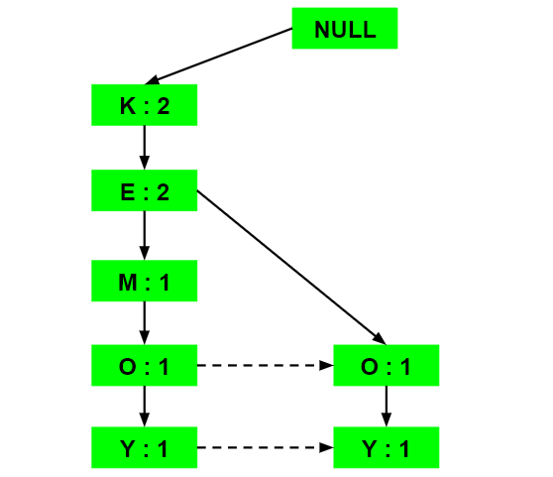
FP-Growth Algorithm
Now, all the Ordered-Item sets are inserted into a Tree Data Structure.
Inserting the set {K, E, M, O, Y}
All the items are simply linked one after the other in the order of occurrence in the set and initialize the support count for each item as 1.
Inserting the set {K, E, O, Y}
Till the insertion of the elements K and E, simply the support count is increased by 1. On inserting O we can see that there is no direct link between E and O, therefore a new node for the item O is initialized with the support count as 1 and item E is linked to this new node. On inserting Y, we first initialize a new node for the item Y with support count as 1 and link the new node of O with the new node of Y.
(a)
(b)

Slide 24
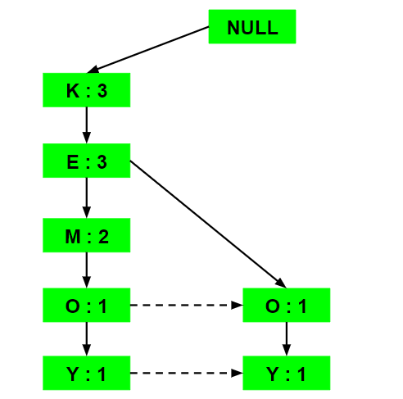
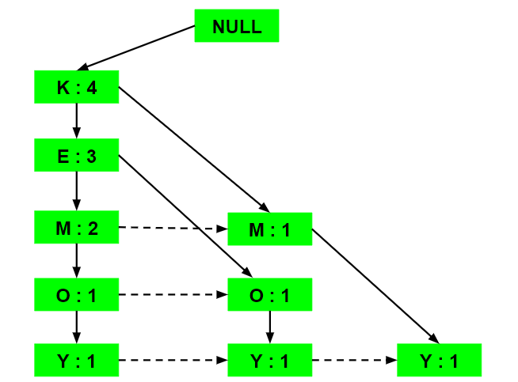
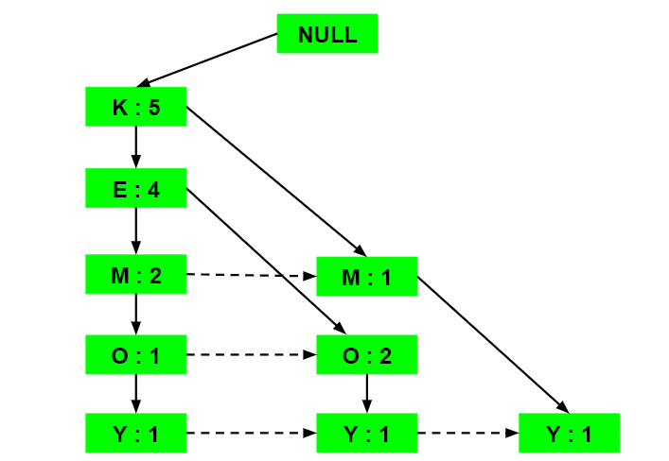
FP-Growth Algorithm
Now, all the Ordered-Item sets are inserted into a Tree Data Structure.
Inserting the set {K, E, M}
Here simply the support count of each element is increased by 1.
Inserting the set {K, M, Y}
Similar to step b), first the support count of K is increased, then new nodes for M and Y are initialized and linked accordingly.
Inserting the set {K, E, O}
We simply the support counts of the respective elements are increased. Note that the support count of the new node of item O is increased.
(c)
(d)
(e)

Slide 25
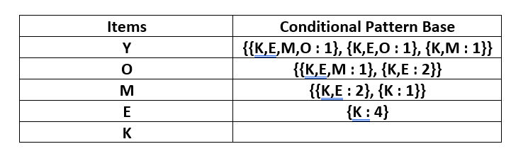
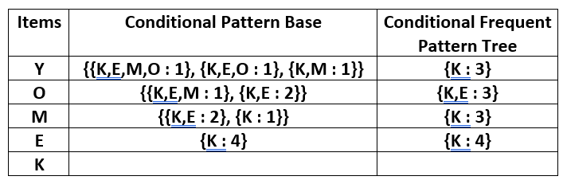
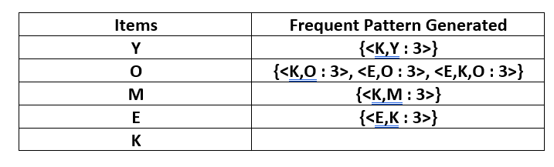
FP-Growth Algorithm
For each item, the Conditional Pattern Base is computed which is path labels of all the paths which lead to any node of the given item in the frequent-pattern tree. Note that the items in the below table are arranged in the ascending order of their frequencies.
For each item, the Conditional Frequent Pattern Tree is built. It is done by taking the set of elements which is common in all the paths in the Conditional Pattern Base of that item and calculating it’s support count by summing the support counts of all the paths in the Conditional Pattern Base.
From the Conditional Frequent Pattern tree, the Frequent Pattern rules are generated by pairing the items of the Conditional Frequent Pattern Tree set to the corresponding item as given in the below table.
For each row, two types of association rules can be inferred for example for the first row which contains the element, the rules K -> Y and Y -> K can be inferred. To determine the valid rule, the confidence of both the rules is calculated and the one with confidence greater than or equal to the minimum confidence value is retained.

Slide 26
Resources/ References
The Unsupervised Learning Workshop by Christopher Kruger; Benjamin Johnston; Aaron JonesPublished by Packt Publishing, 2020.
Hands-On Unsupervised Learning Using Python, by Ankur A. Patel, Published by O'Reilly Media, Inc., 2019.
Mastering Machine Learning with Spark 2.x, Alex Tellez, Max Pumperla, Michal Malohlava, Packt Publishing, August 2017
https://www.geeksforgeeks.org/ml-frequent-pattern-growth-algorithm
Copyright Notice The following material has been communicated to you by or on behalf of CCT College Dublin in accordance with the Copyright and Related Rights Act 2000 (the Act). The material may be subject to copyright under the Act and any further reproduction, communication or distribution of this material must be in accordance with the Act. Do not remove this notice

